Slide 1
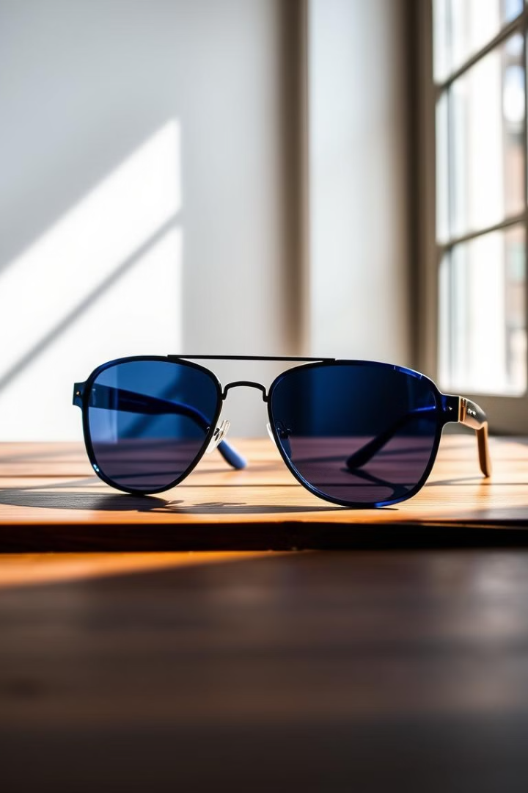












Glarewear: A Modern Eyewear Brand

Slide 2
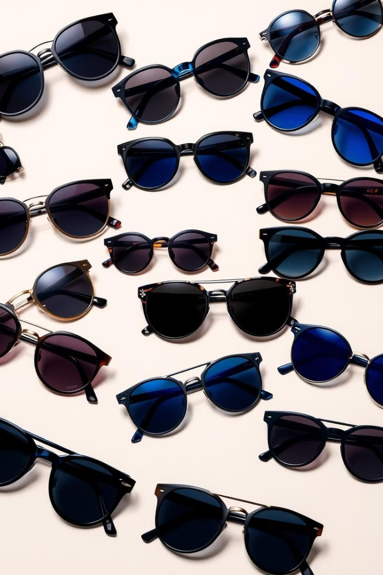
Prepared By :
1
Meet Panara
2
Nevil Savaliya
3
Jainam Prajapati
4
Aayush Rokad
5
Harsh Tarpara

Slide 3







Glarewear's Strengths
Cost-Effective
Customization Options
Quality Enhancement
Glarewear offers competitive pricing while prioritizing quality materials.
Magnetic attachments allow for endless style variations, catering to individual preferences.
Improve eye health and protect against digital eye strain.
Glarewear

Slide 4



Addressing Challenges and Limitations
Output Quality
Return and Refund Policies
Glarewear must consistently meet customer expectations on quality and design standards.
Transparent and customer-friendly return and refund policies are essential for building trust.
Marketing Challenges
Competing in a crowded market requires effective marketing strategies to establish brand recognition.
Glarewear

Slide 5
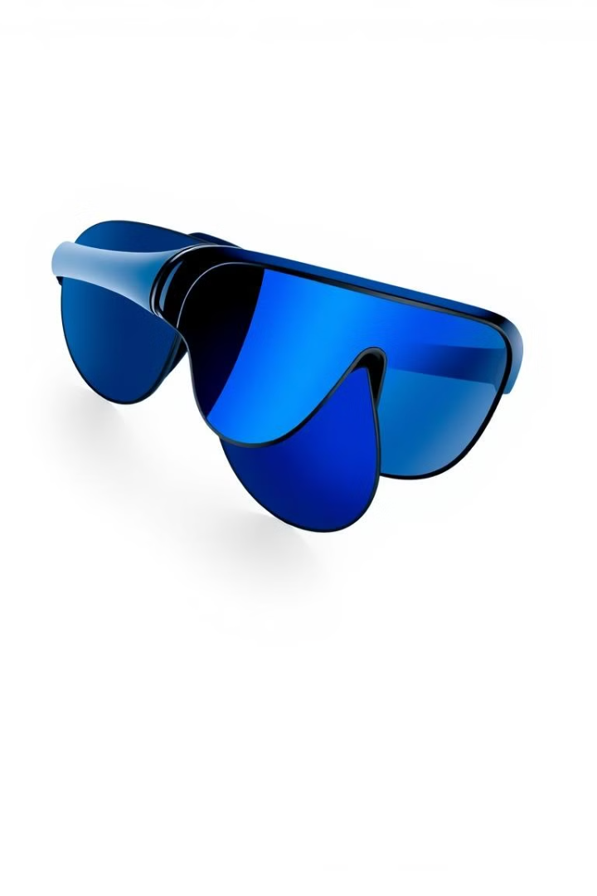



Future Opportunities for Glarewear
Glarewear can integrate new technologies like photochromic lenses or anti-fog coatings, enhancing product features.
Using eco-friendly materials will appeal to environmentally.
Glarewear can expand its target audience by offering diverse styles and designs to cater to different demographics.

Slide 6

Building a Strong Brand
1
Glarewear should highlight its key advantages, including customization options, high-quality materials, and competitive pricing.
2
By addressing areas for improvement, such as quality control and return policies, Glarewear can enhance customer satisfaction.
3
Implementing strategic marketing initiatives can help Glarewear expand its market share and achieve growth.

Slide 7
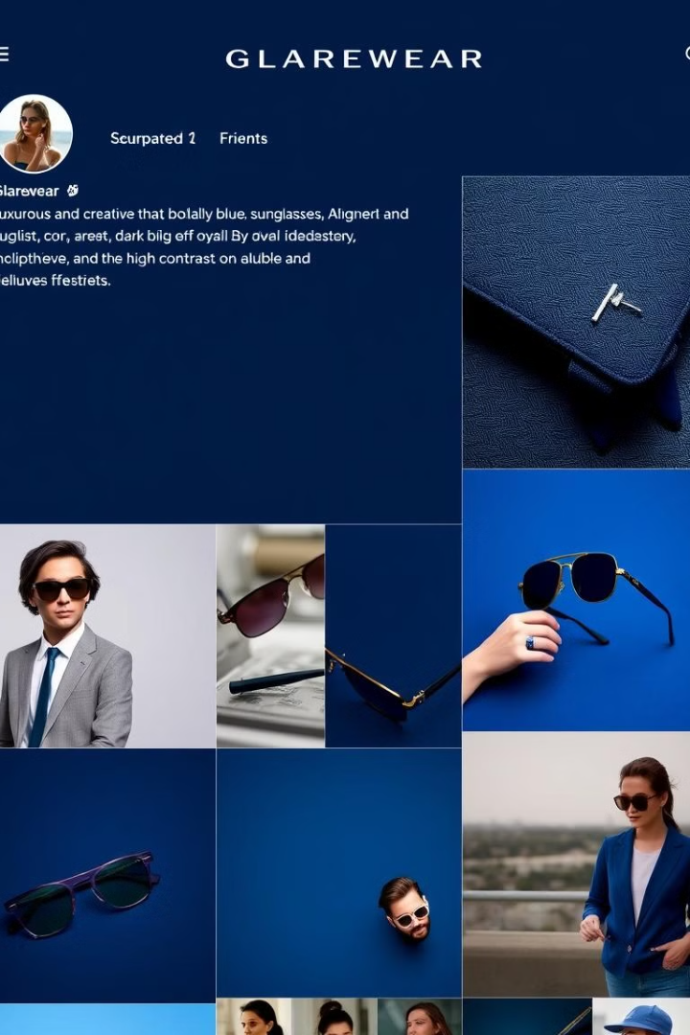



Conclusion
Continuously seeking feedback and adapting to market trends will be crucial for Glarewear to stay competitive in the eyewear industry.
Investing in research and development to innovate new products and technologies can also open doors for future growth opportunities.
Glarewear

